Slide 1

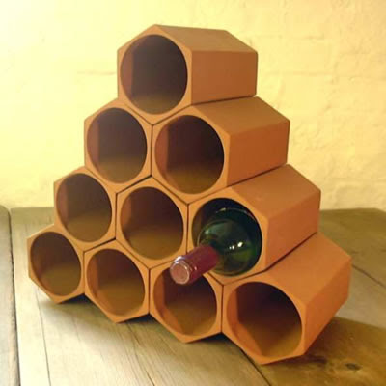
Wine reviews
By: nate hoffelmeyer, Sam Harvey and erin cali

Slide 2
Summary of results
Observing a non-zero dataset of over 90,000 descriptions of wine
Distribution of wines by points skewed the data slightly to the right
Wines with higher point values tend to have longer descriptions
Of the 3 modeling techniques we used, Random Forest Classifier had the highest precision and recall
97% on quality buckets
96% on the varieties

Slide 3
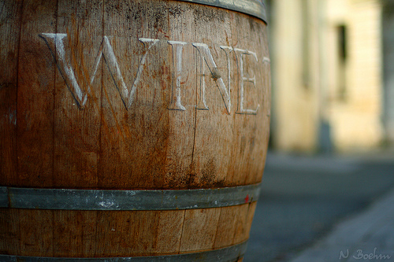
specification
Our goal was to create a model that will help predict different varieties and sources of wines based off of descriptions and customer reviews.
We gathered our data from kaggle and had approximately 92,000 descriptions
3 modeling techniques were used:
Random Forest Classifier
Multinomial Naïve Bayes
Logistic Regression

Slide 4

Observations
Distribution of wine by points is slightly skewed right
The higher the point value the rarer the wine
Expected that most wines would center around average quality
Wines with higher point values tended to have longer descriptions
It is assumed that the better quality of wine the more enjoyable people find it to talk about and describe so to say

Slide 5
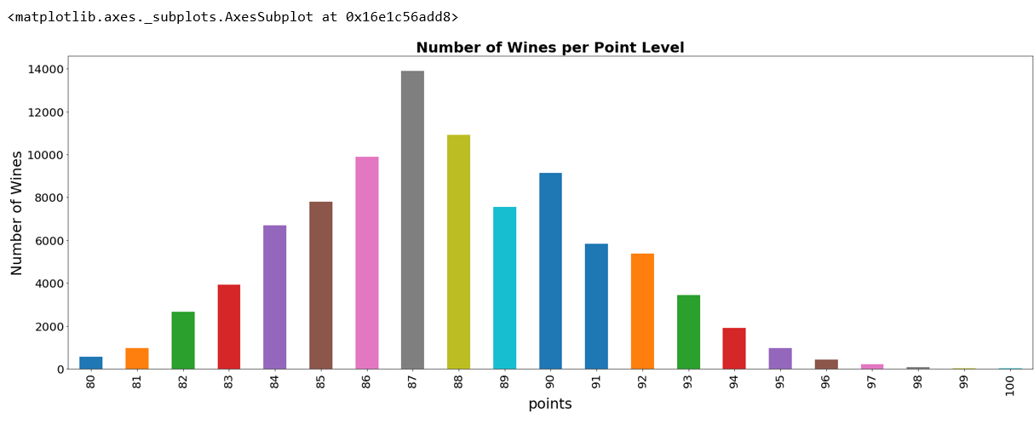
Analysis
Created a data frame just points and descriptions for analysis
Determined 87.74 was the average point score for wines

Slide 6
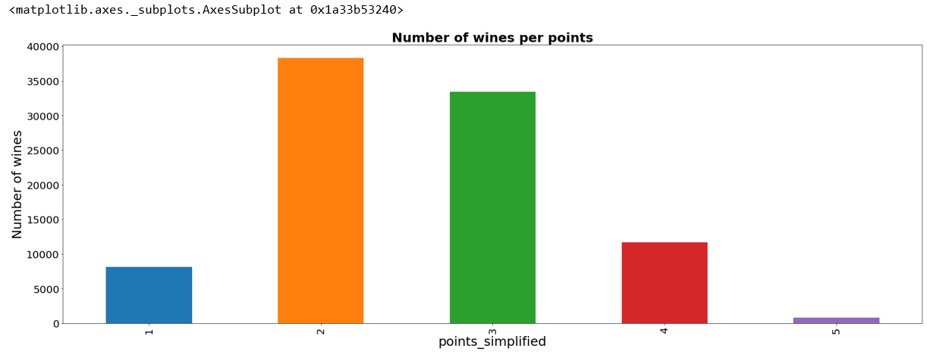
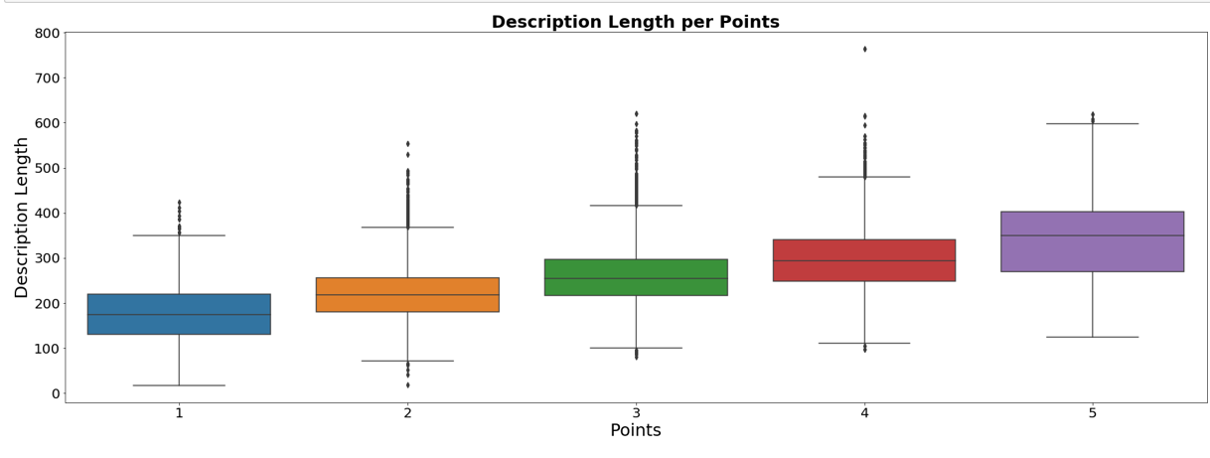
Analysis
In order to reduce the burden our model we decided to simplify our model, giving each wine a range of points they could fall into
We simplified the model down from 90 points to just 5

Slide 7
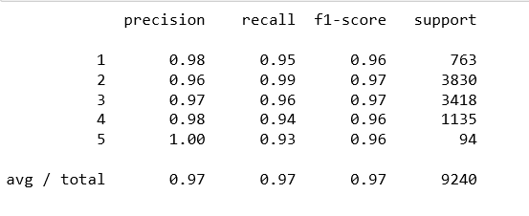
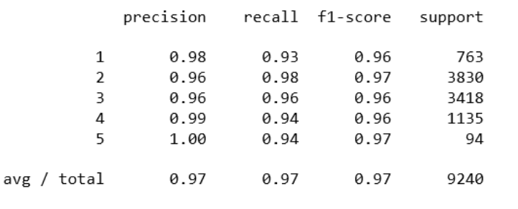
Quality and Random Forest Classifier analysis
Count vectorization
Tfidf vectorization

Slide 8
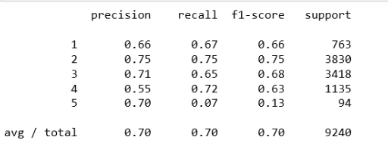
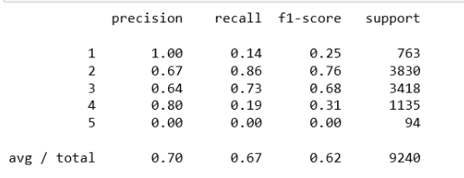
Multinomial naïve bayes analysis
count vector
tfidf

Slide 9
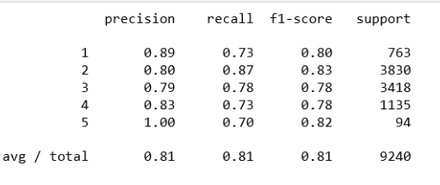
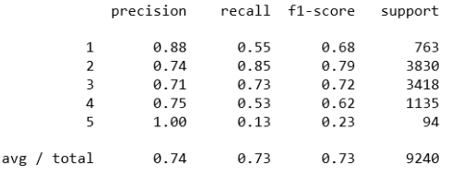
Logistic regression analysis
Count vector
Tfidf

Slide 10
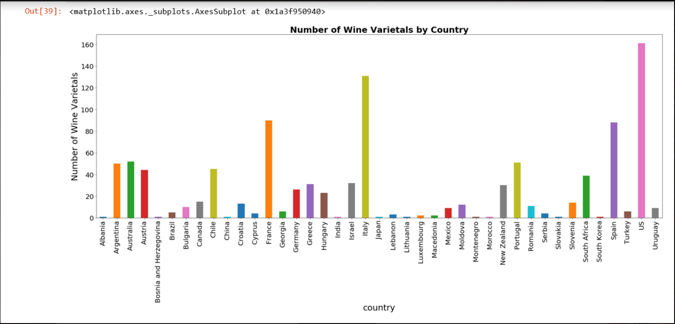
Varietal analysis
The next step in our analysis was to determine whether or not we could predict a type of wine by description.
With such a large amount of varietals we added country in order to get a sense of overall distribution

Slide 11
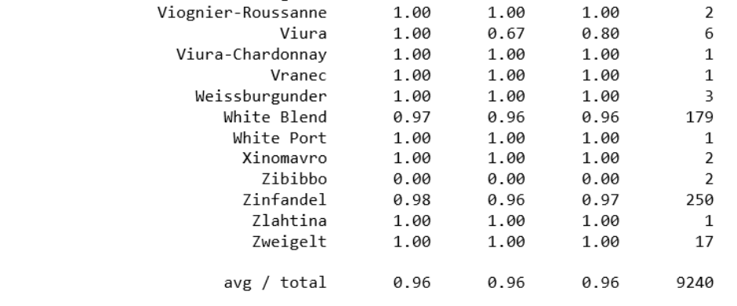
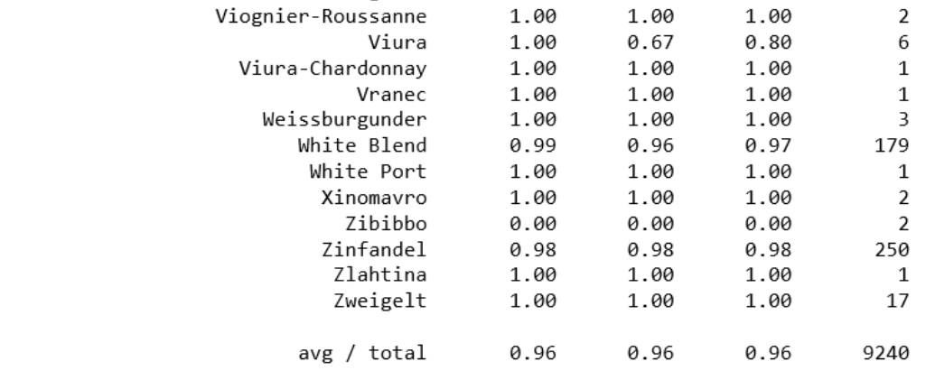

Random forest classifier analysis
vectorizer
tfidf
RANDOM FOREST HAD A 96% PRECISION AND RECALL

Slide 12
recommendations
Continue to refine the all of the models that we ran with a focus of improving precision and recall.
Random Forest Classifier has the highest percentage of the three models but even has room for improvement
If possible to raise the percentages of precision and recall in the logistic or multinomial models they are less computationally intense than Random Forest Classifier.
Try running a support vector machine model or a kernel svm

Slide 13
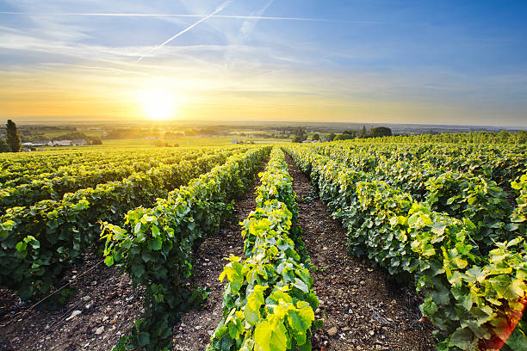
references
https://www.kaggle.com/zynicide/wine-reviews

